Slide 1
Real-Time E-commerce Voice using LiveKit

Slide 2
🧭 Presentation Agenda
Introduction & Project Motivation
Problem Statement in E-Commerce Support
Why Voice-Based AI Systems
Proposed E-Commerce Voicebot Solution
Real-Time Audio & WebRTC (LiveKit)
AI Reasoning Layer (GPT-4o Realtime)
Tool-Based RAG using MCP
Safety, Reliability & User Experience
Limitations of the Current System
Business Relevance & Impact
Conclusion & Key Takeaways

Slide 3
🧭 1. Introduction & Project Motivation
Voice is becoming the primary interface for digital customer support
Customers expect instant and natural interactions
Text chatbots lack emotional tone and speed
Human call centers are costly and hard to scale
AI voice agents can reduce support costs significantly
Real-time voice improves accessibility and user experience
This project explores how AI can replace basic support calls

Slide 4
🧭 2. Problem Statement in E-Commerce Support
Customers repeatedly ask about orders and delivery
Return and refund queries create high load
Agents must check multiple systems
Delays reduce customer satisfaction
Chatbots often give incorrect answers
Companies need reliable automation
Voice provides a natural interface

Slide 5
🧭 3. Why Voice-Based AI Systems
🧭 4. Proposed E-Commerce Voicebot Solution
Speaking is faster than typing
More accessible for all users
Feels more human
Enables hands-free support
Better for mobile users
Matches real call-center flow
Improves customer trust
Real-time AI voice assistant
Users speak through browser
AI understands queries
Fetches backend data
Responds with natural speech
Supports orders, products, returns
Designed like a virtual agent

Slide 6
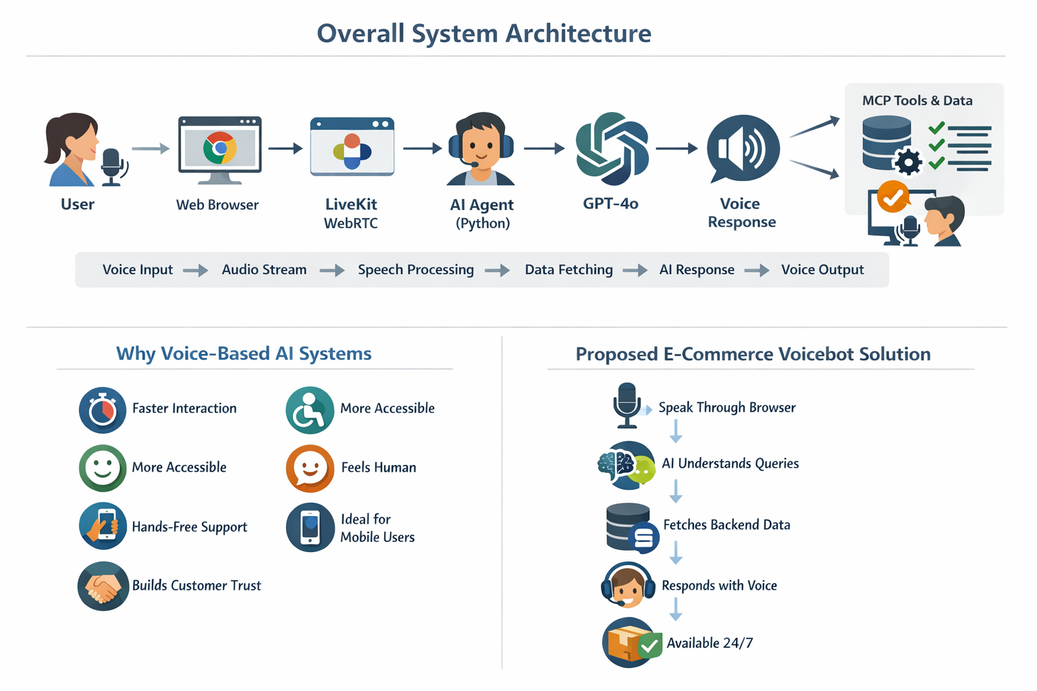

Slide 7
🧭 5. Real-Time Audio & WebRTC (LiveKit)
🧭 6. AI Reasoning Layer (GPT-4o Realtime)
LiveKit uses WebRTC
Enables low-latency voice
Same tech as Zoom
Streams audio in real time
Works in browsers
Connects users to agents
Supports scalable calls
Converts speech to text
Understands user intent
Applies system rules
Calls tools when needed
Builds correct response
Converts text to voice
Handles entire AI pipeline

Slide 8
🧭 7. Tool-Based RAG using MCP
🧭 8. Safety, Reliability & User Experience
AI does not guess data
Calls MCP tools
Reads CSV datasets
Gets order and product info
Uses real business data
Prevents hallucinations
Ensures accuracy
Requires valid IDs
No payments or cancellations
Explains missing data
Polite voice responses
No fake information
Clear limitations
Builds customer trust

Slide 9
🧭 9. Limitations of the Current System
🧭 10. Business Relevance & Impact
No login system
Data stored in CSV
No real payment gateway
English only
Prototype environment
Limited scalability
Mock data only
Reduces support costs
Handles large call volume
Improves customer experience
Always available
Fast response time
Scalable solution
Suitable for e-commerce

Slide 10
🧭 11. Conclusion & Key Takeaways
Built real-time voice AI
Uses WebRTC and LiveKit
Uses GPT-4o and MCP
Accurate and safe
Meets Boston requirements
Production-style system
Ready to scale

Slide 11
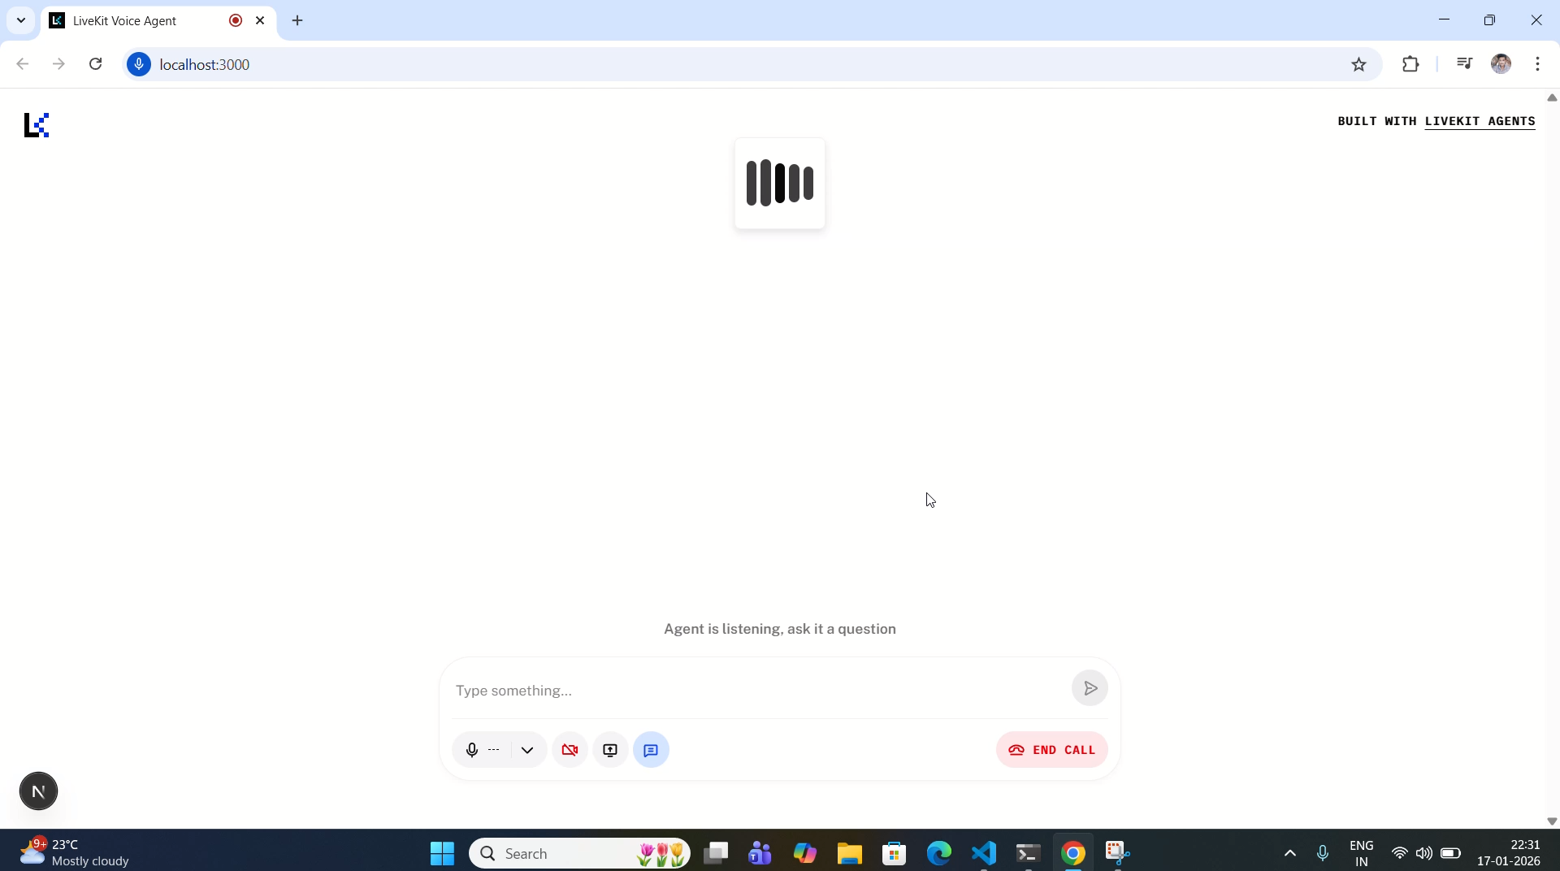
Demo

Slide 12
Questions ?

Slide 13
Thank You!

